Slide 1
Sydney Kotlin Meetup Building an End to End Secure, Scalable IoT Serverless Solution
Dave Glover,
Microsoft Australia
Cloud Advocate
Follow me @dglover
https://github.com/gloveboxes/iot-ttn-kotlin-azure-functions

Slide 2
Agenda
Solution Overview
Azure Java/Kotlin Support
Serverless with Functions
Real-time communications with web apps and SignalR
Azure Storage and Static Websites

Slide 3
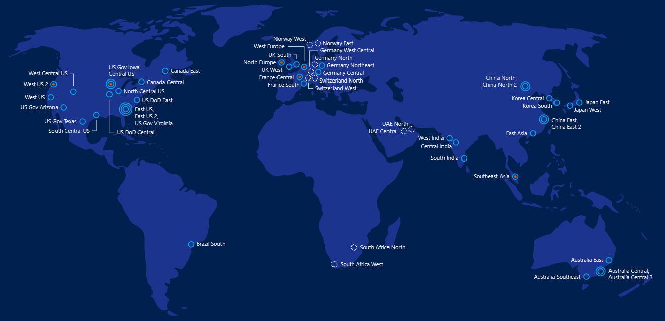
54
140
Azure regions in
countries

Slide 4
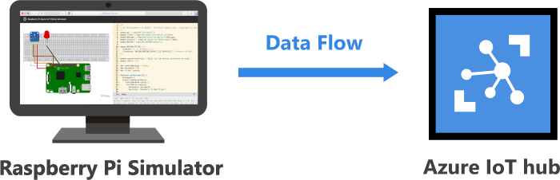
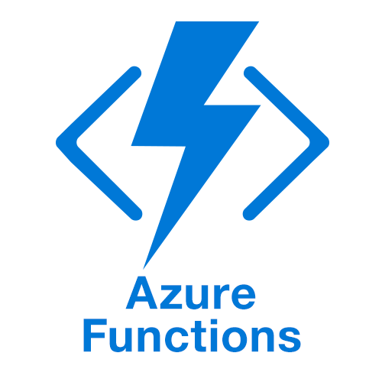
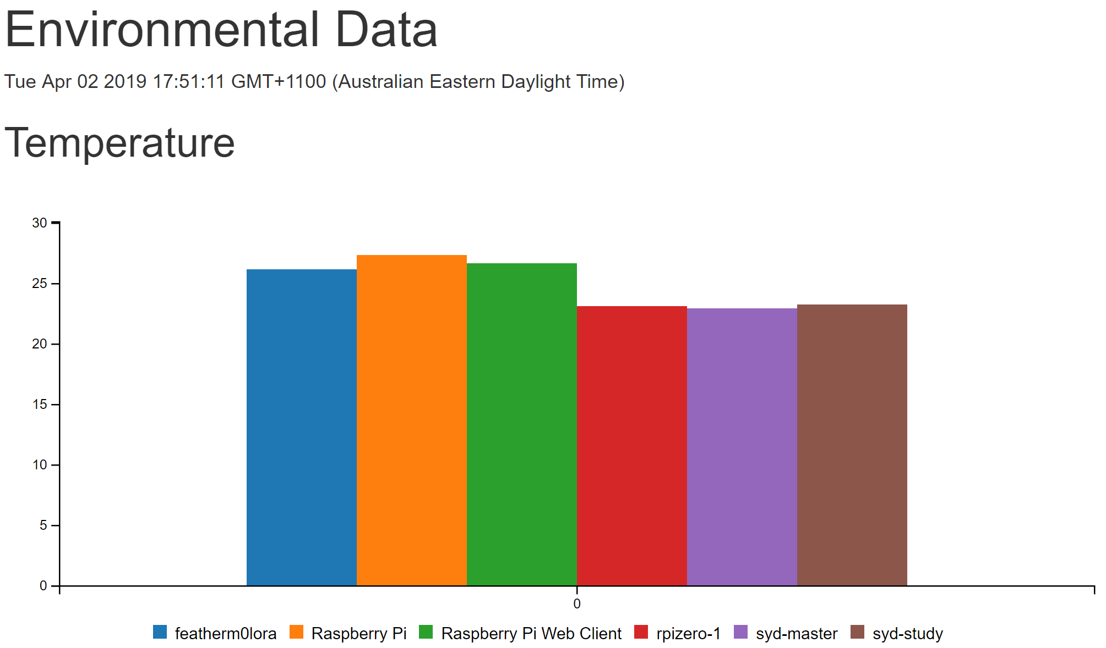
What we will cover
Simulated Raspberry Pi
(Azure IoT Hub)
Serverless & Kotlin Azure Functions
Serverless Websites
(Azure Storage Static Websites)

Slide 5
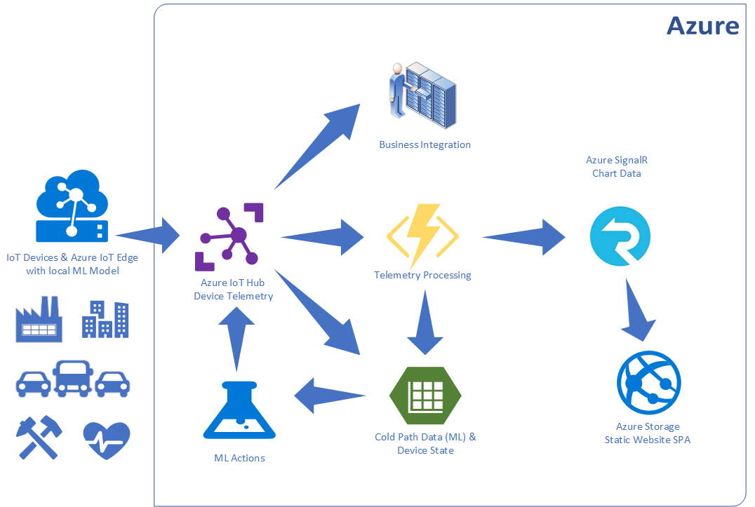
Integration IoT and Business

Slide 6



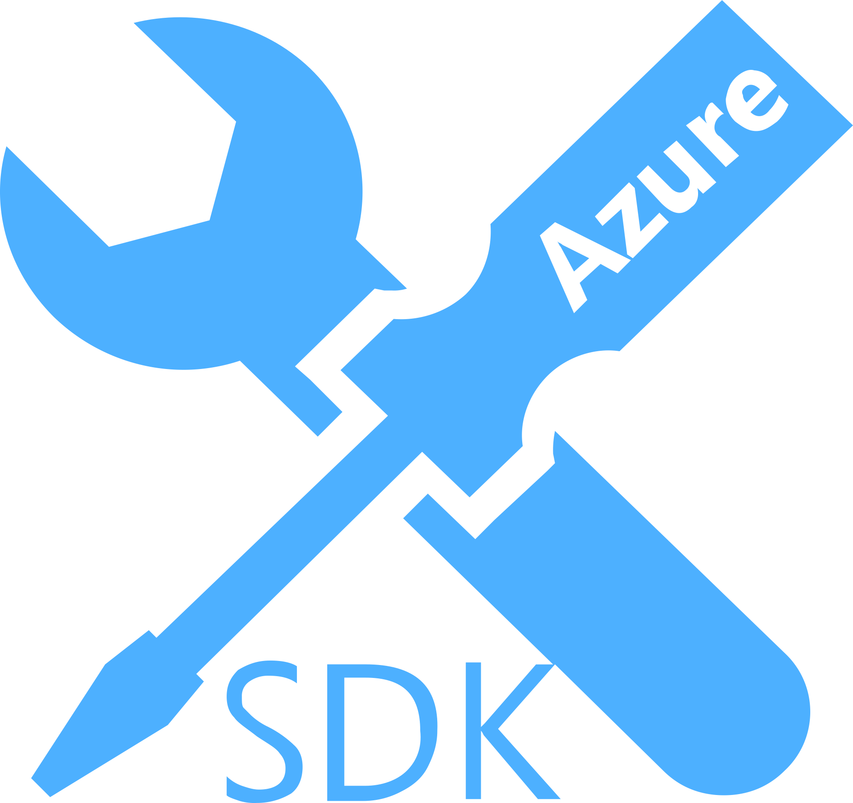
Java Cloud Native on Azure – Landscape
Azure Services
CosmosDB
Service Fabric
App Service
Container Instances
Container Registry
Kubernetes Service
Serverless Functions
App Insights
Azure DevOps
SQL Service
Event Grid
Event Hub
Service Bus
Active Directory
Multi-Cloud Platforms
JVMs, Frameworks, Runtimes
Tools
DevOps
IaaS – Linux Distributions
Cloud Automation
Kubernetes & Containers
OSS Foundations
Microsoft SDKs for Java Over 50+ services covered
On Azure, approx 50% of workloads are Linux-based.
Notes:
All of these are supported on Azure with strong relationship between Microsoft and the vendors and project leaders of these technologies.

Slide 7
1st Class Support for Java on Azure Services
Native and idiomatic support for Java applications.
Azure Functions
Java SE 8
Java SDK
Plugins for Maven, Eclipse, and IntelliJ
VS Code Extension (manage; local/remote debug)
Azure Cosmos DB
Java SDK for synchronous connections
Java SDK for asynchronous (reactive) style
Support for MongoDB/Cassandra APIs
Open Source SDKs
Azure Application Insights
Java SDK for user-defined instrumentation
Java Agents for auto instrumentation
Eclipse Plugin
Open Source SDKs
Azure Service Fabric
Java API
Java SDK
Maven Dependencies and Plugins
Eclipse Plugins and VS Code Extensions
Azure SDKs for Java
Management APIs (CRUD Azure services)
REST-to-Java APIs (idiomatic low-level REST API)
Fluent APIs (idiomatic service features)
Over 50+ services covered
Open Source SDKs
Azure App Service
Java SE 8
Tomcat 8.5, 9.0
Maven Plugin
Eclipse & IntelliJ Plugins
VS Code Extension (Manage)
Notes:
Service Fabric is Azure’s Cloud Native Platform, now fully open sourced. It is in the same space as Pivotal Cloud Foundry and Red Hat OpenShift. Microsoft’s investment in Service Fabric aims to bring native features already in .NET applications to Java applications as well.

Slide 8
Serverless with Azure Functions

Slide 9
What is Serverless?
No infrastructure headaches
Scales on demand
Very cheap to run

Slide 10

Functions as a Service (FaaS)
Functions as a Service
Single Responsibility, Short Lived, Stateless, Event Driven & Scalable
Azure Functions (Implementation of FaaS)
Great Local Developer Experience
Hosting Flexible
Consumption Plan, App Service Plan, Premium, and Container
Consumption plan
Free grant of 1 million requests and 400,000 GBs per month
Open Source https://github.com/Azure/Azure-Functions

Slide 11
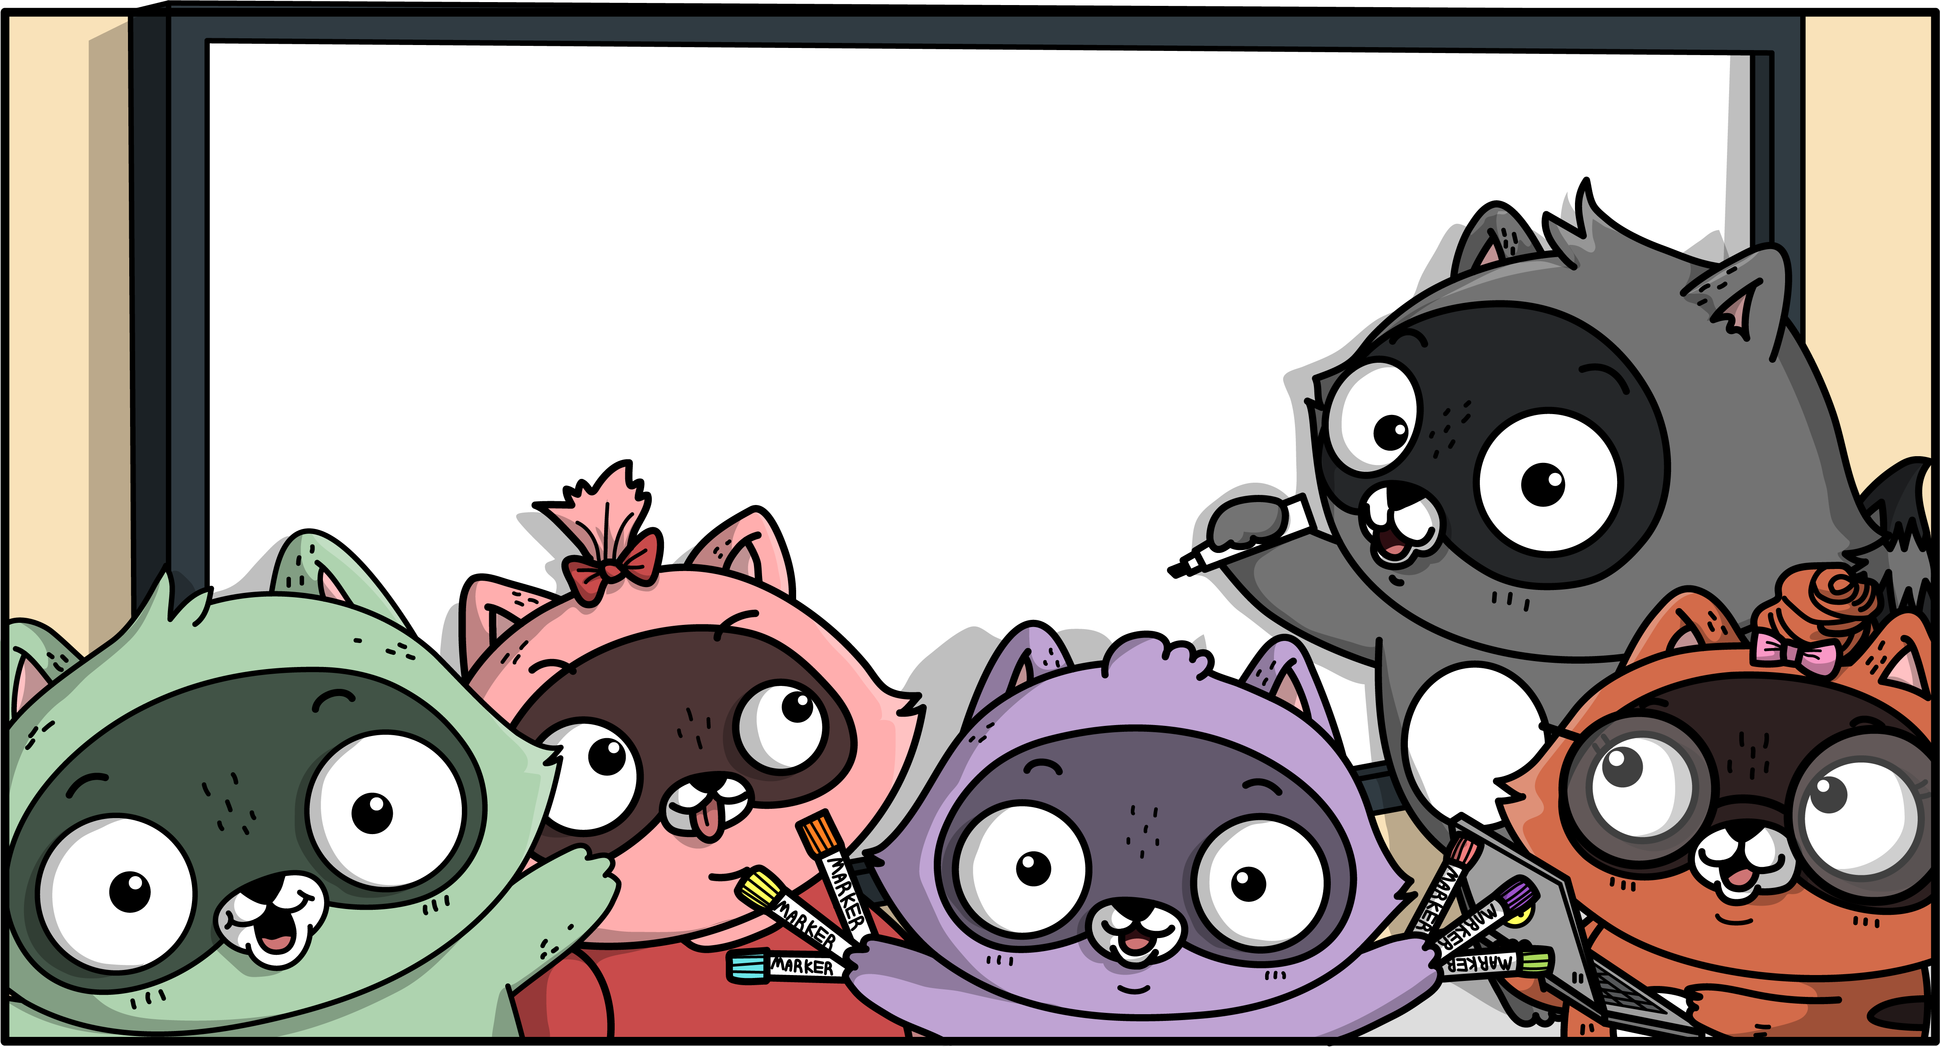


Slide 12
Demo
Creating an Azure Function with IntelliJ
Adding Maven Archetype
Azure-Function:Add
Convert to Kotlin
Azure-Function:Run
-DenableDebug
Raspberry Pi Simulator

Slide 13
Serverless Web Pages & Azure SignalR

Slide 14
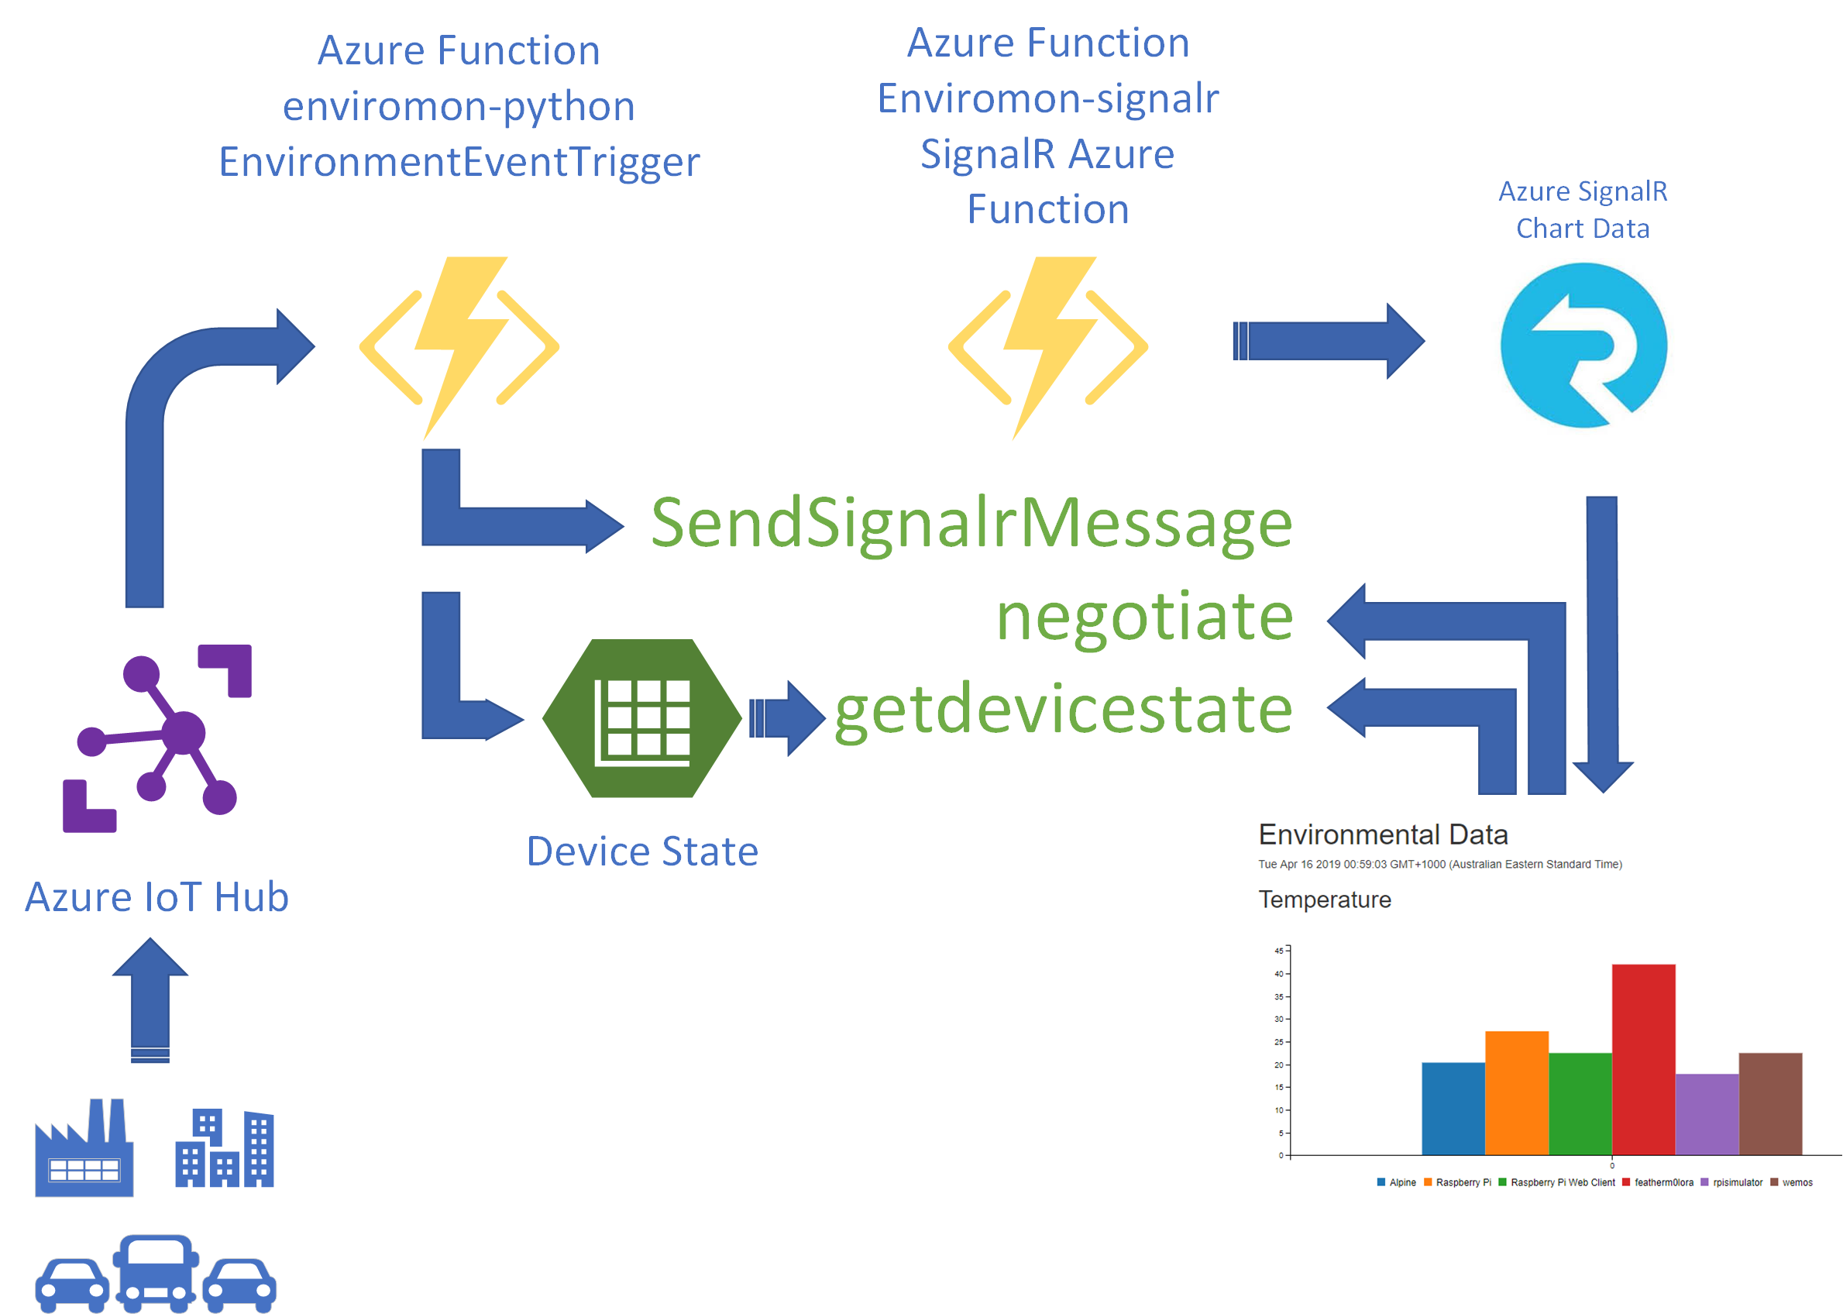
SignalR in Actions

Slide 15


SignalR in Action
Azure IoT Hub
Azure Function
Telemetry Processor
Azure SignalR Service
Browser
Desktop
Mobile
Game
Event Hub Trigger
SignalR Output Binding
WebSocket, Server Sent Events,
and Long Polling

Slide 17
Demo
SignalR Trigger
Azure Storage Static Websites and Single Page Apps

Slide 18
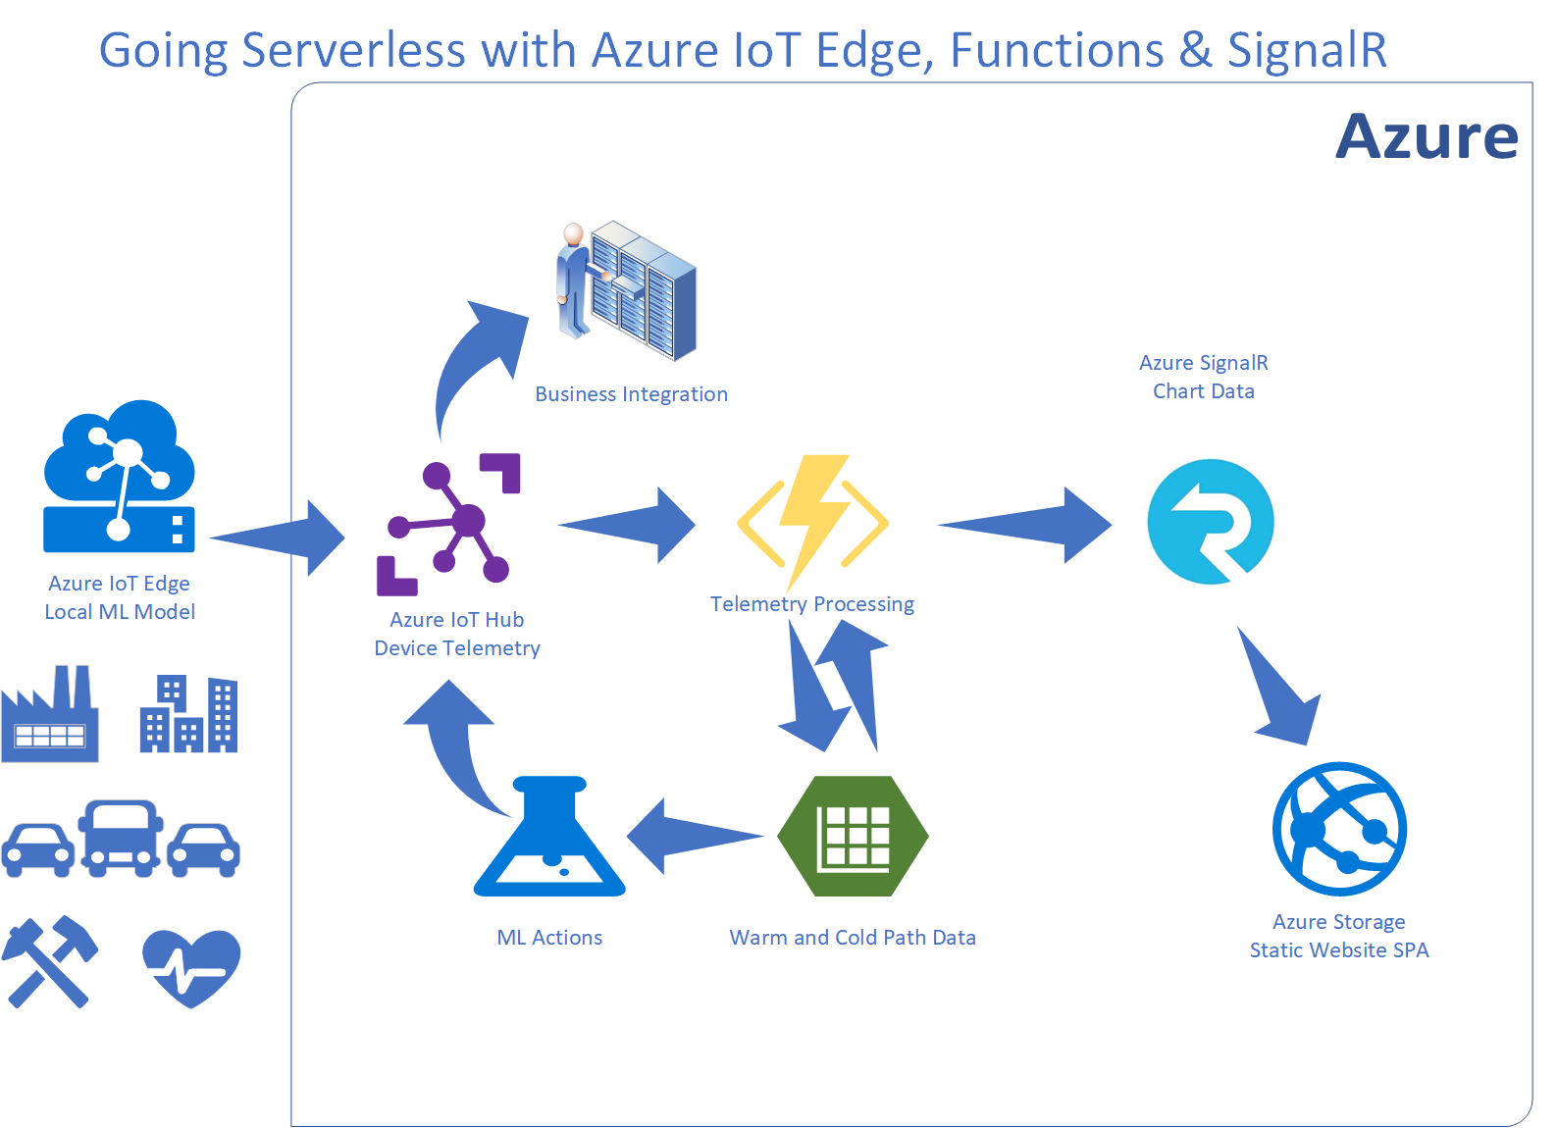
Session Summary

Slide 19
Resources
Create your first Azure function with Java and IntelliJ
Create your first function with Java and Maven
Maven Archetype For Azure Functions
Microsoft Azure Storage Client SDK
Azure SignalR Service Documentation
Static website hosting in Azure Storage
Demoed Solution on GitHub (gloveboxes)
Remote Debugging Java Azure Functions

